Slide 1
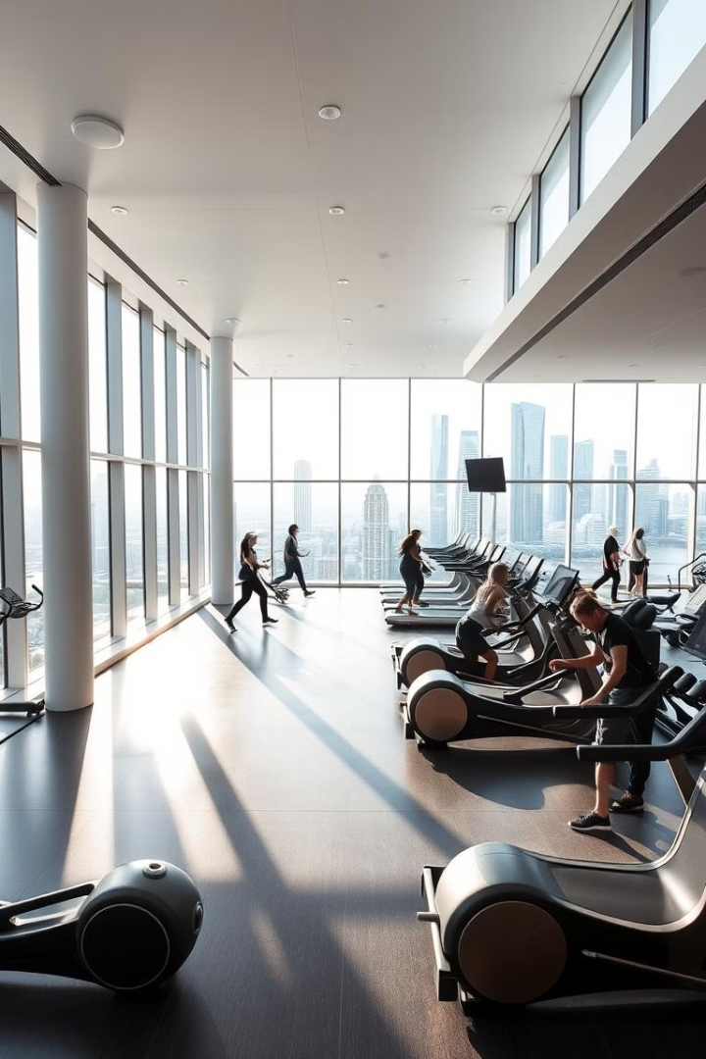
Life Gym
Welcome to our state-of-the-art gym, where fitness meets innovation. We offer a wide range of services and amenities to help you achieve your fitness goals.

Slide 2
Work Team :-
Mahmoud Mamdouh
Mo'men Mfreh Hussien
Mahmoud Abulftooh Sabra
Jehad Ashour Fares
Amnaa Mohammed Abdallah
Abd-allah Ramdan Hassan

Slide 3
HTML
CSS
Bootstrap
JavaScript
Material Used :-

Slide 4
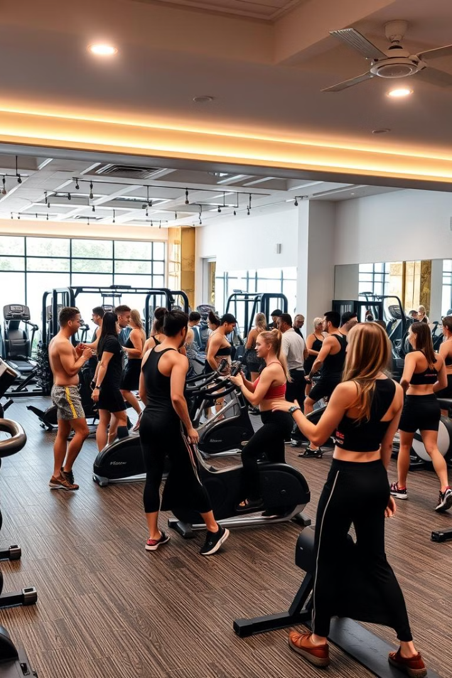
Types of Exercise Available
1
Cardiovascular Training
2
Strength Training
Lift weights, use resistance bands, and engage in bodyweight exercises to build muscle and strength.
Choose from treadmills, ellipticals, stationary bikes, and rowing machines for a great cardio workout.
3
Group Fitness Classes
4
Personal Training
Work one-on-one with a certified personal trainer to create a customized workout plan and achieve your specific fitness goals.
Participate in dynamic and engaging classes like Zumba, spin, yoga, and Pilates to improve your fitness and have fun.

Slide 5
Facilities & Equipment
Cardio Zone
Strength Training Area
Group Fitness Studio
Our cardio zone is equipped with top-of-the-line treadmills, ellipticals, stationary bikes, and rowing machines. You can track your progress on interactive displays and personalize your workout with various programs.
Our strength training area features a variety of free weights, weight machines, and resistance bands, allowing you to target different muscle groups and customize your workouts.
We have a dedicated studio for group fitness classes, providing a spacious and well-equipped environment for a variety of programs, including Zumba, spin, yoga, and Pilates.

Slide 6
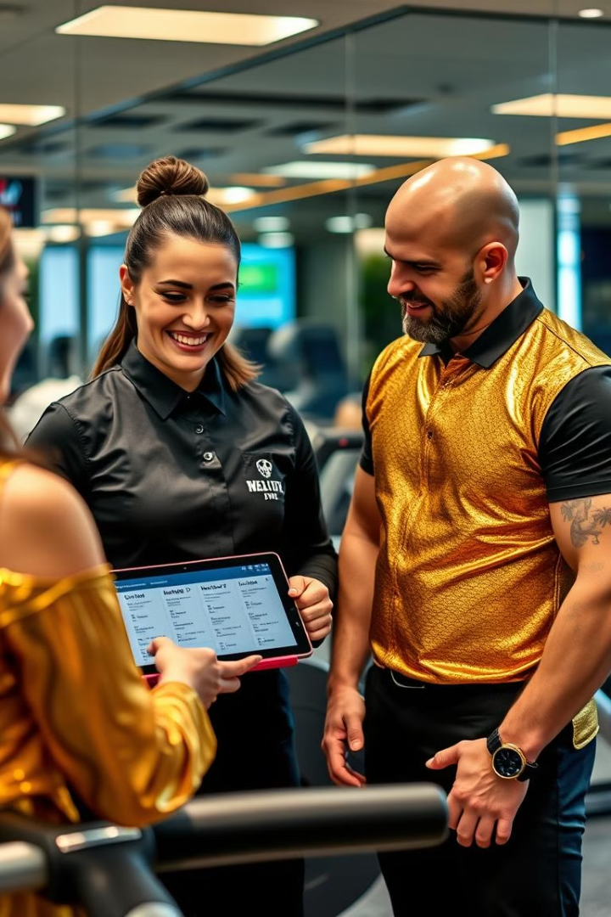
Membership Plans & Packages
Plan
Features
Price
monthly
Access to gym facilities and equipment
1000 egp
semi annual
All basic features plus access to group fitness classes
5000 egp
annual
All premium features plus personal training sessions
9000 egp

Slide 7

Benefits of Joining
Improved Physical Health
Enhanced Mental Wellbeing
Regular exercise helps you maintain a healthy weight, reduce the risk of chronic diseases, and increase your energy levels.
Working out releases endorphins, which have mood-boosting effects, reducing stress and anxiety.
Social Connections
Professional Guidance
Our gym offers a welcoming community where you can connect with other fitness enthusiasts and make new friends.
Our qualified staff is always available to answer your questions, provide support, and help you reach your fitness goals.

Slide 8




Testimonials & Success Stories
Member Testimonials
Read what our members have to say about their experience at our gym and how it has positively impacted their lives.
Success Stories
Discover inspiring stories of individuals who achieved their fitness goals with the help of our gym and its dedicated staff.
Community Support
Our gym fosters a strong sense of community, providing a supportive environment for everyone to reach their full potential.

Slide 9
Upcoming updates
Barcode Login System
More admin control
Meals-calory system
Payment portal system

Slide 10
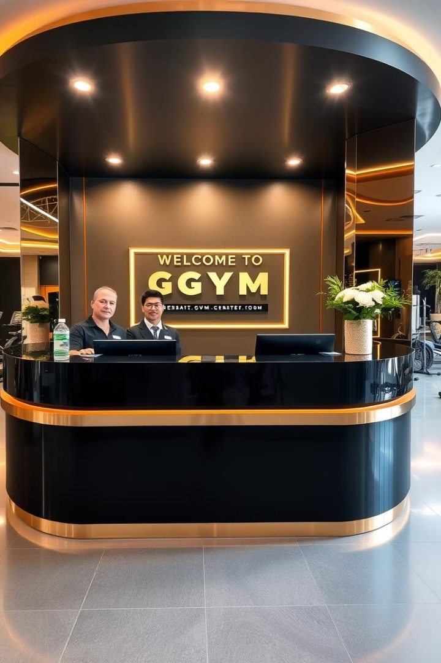
Contact Us
Visit our website or contact us directly to learn more about our services, membership options, and special offers.

